Slide 1
Platforms
Six Part Series (3 of 6)

Slide 2
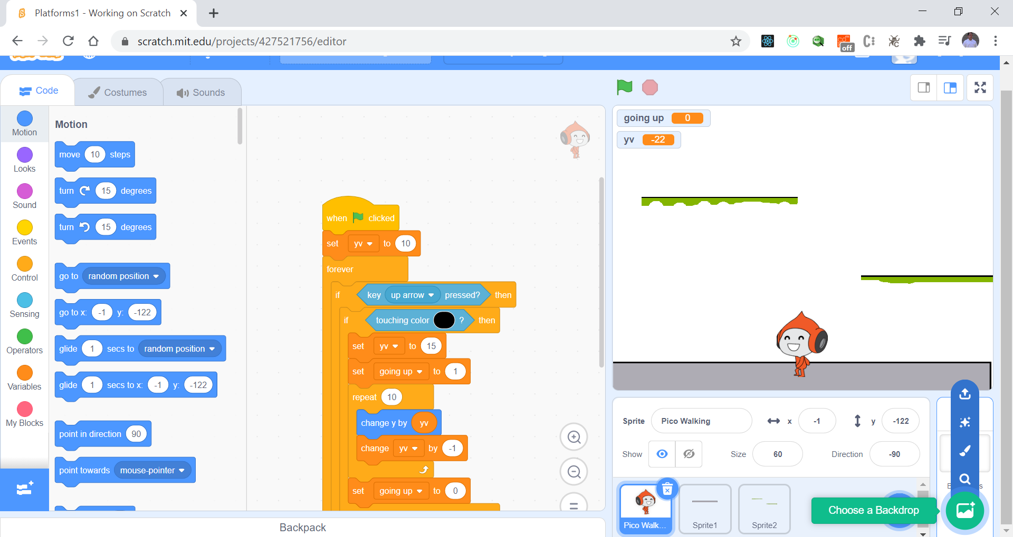
Let’s add a background
Also need to move properly when in air.
Let’s solve these problems.

Slide 3
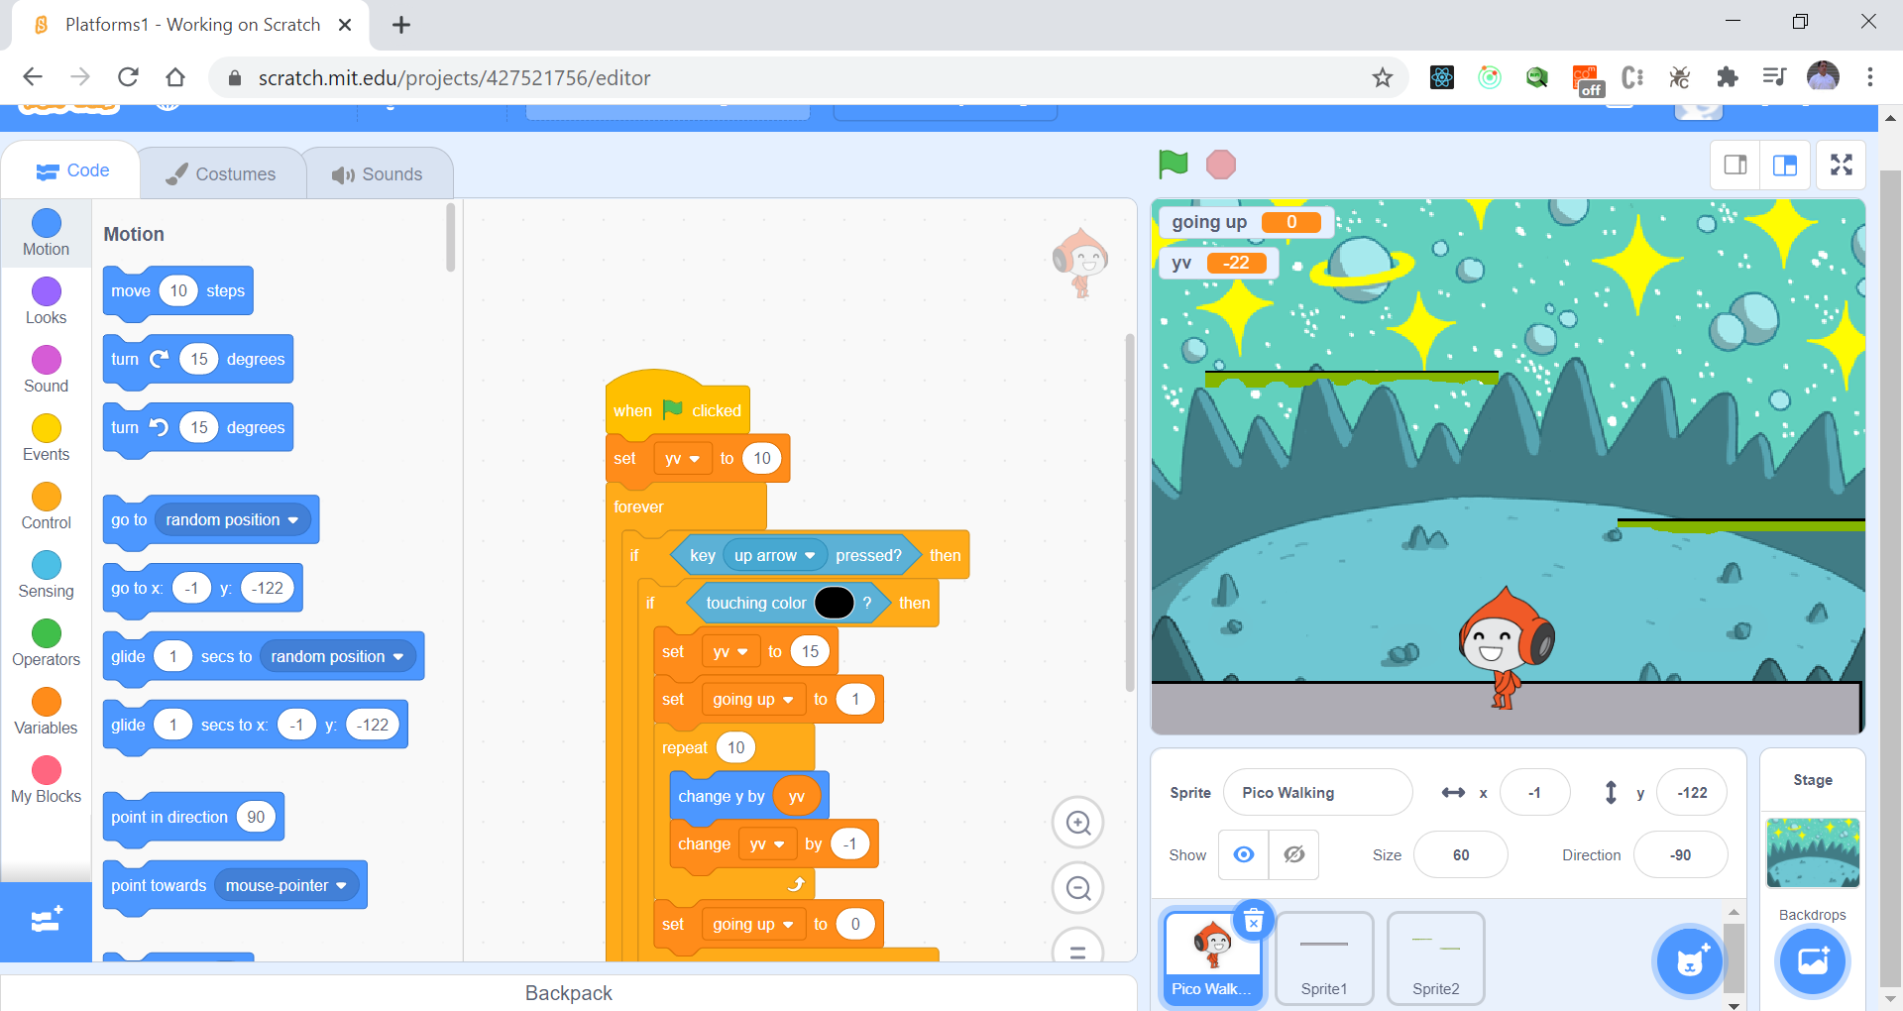
Choose Space

Slide 4
Let’s make better platforms and cleanup
Create a Level 1
And
Create a Level 2

Slide 5
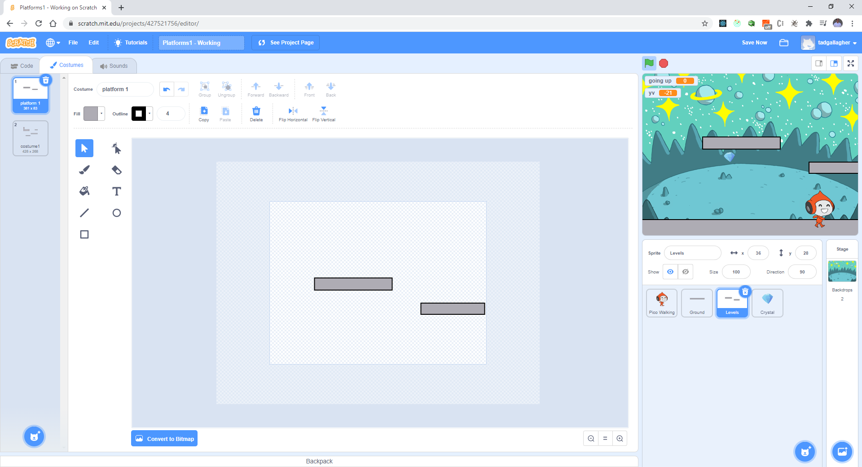
Level 1

Slide 6
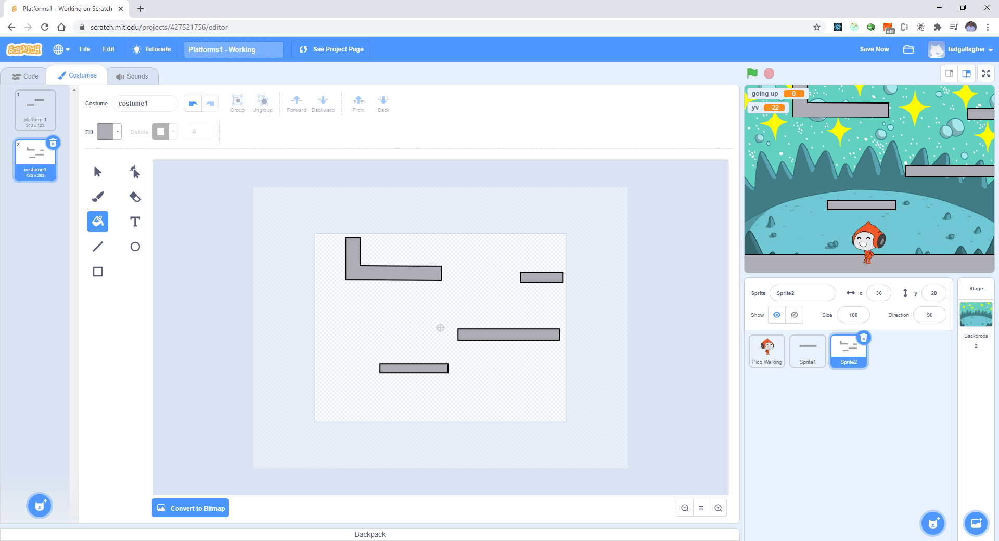
Level 2

Slide 7
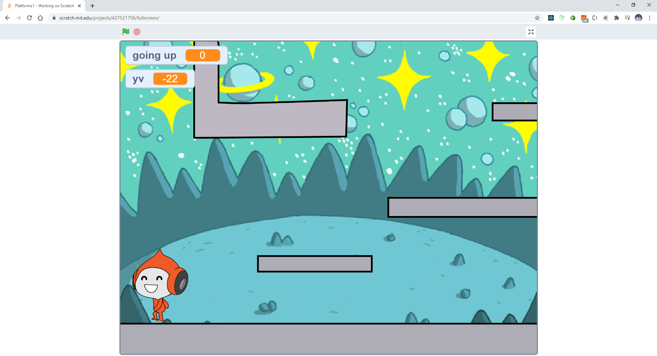
Let make sure Pico starts from the lower left

Slide 8
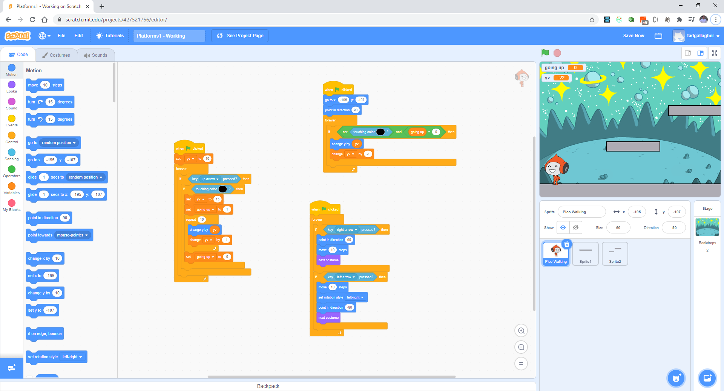
Add the follow code to ensure direction and position

Slide 9
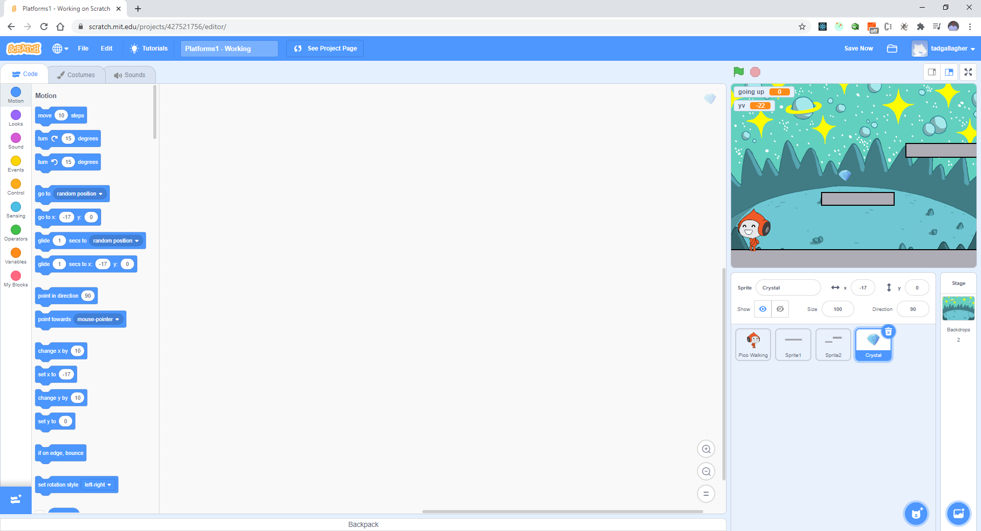
Let’s create prizes for Pico to catch and move to next level – Add a Diamond (Crystal)

Slide 10
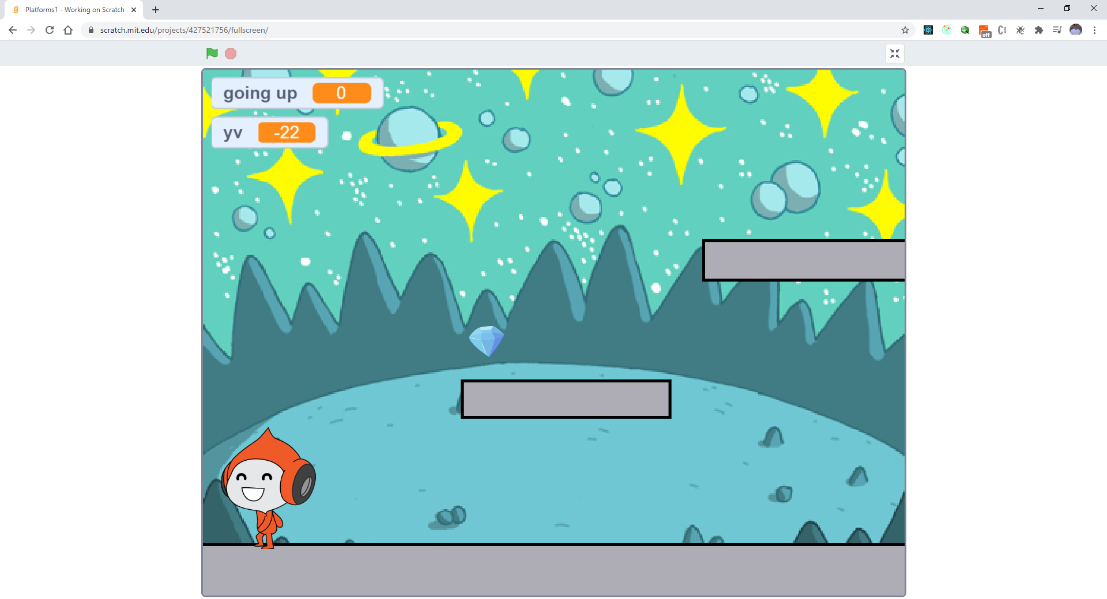
The goal is to catch the diamond

Slide 11
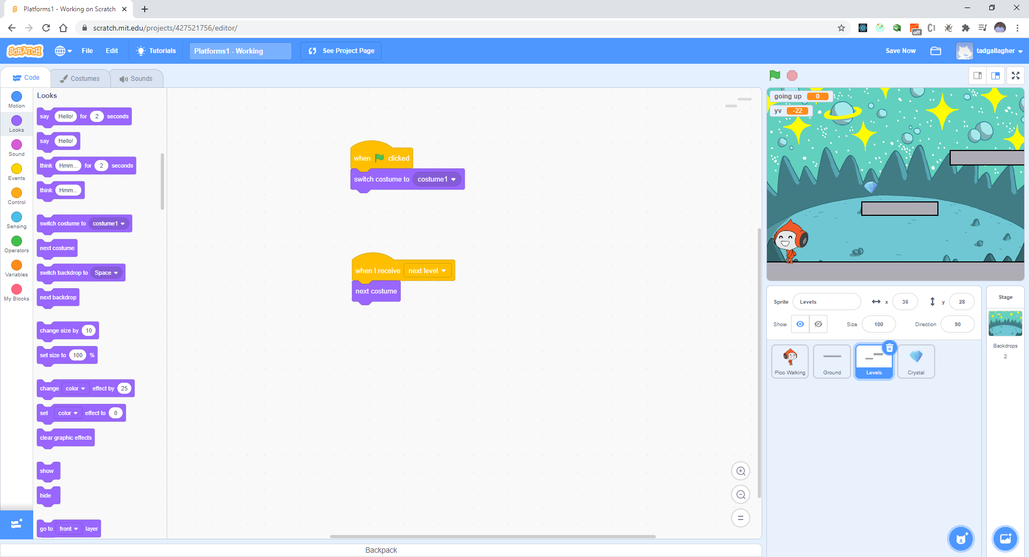
When Pico touches the diamond we move to next level

Slide 12
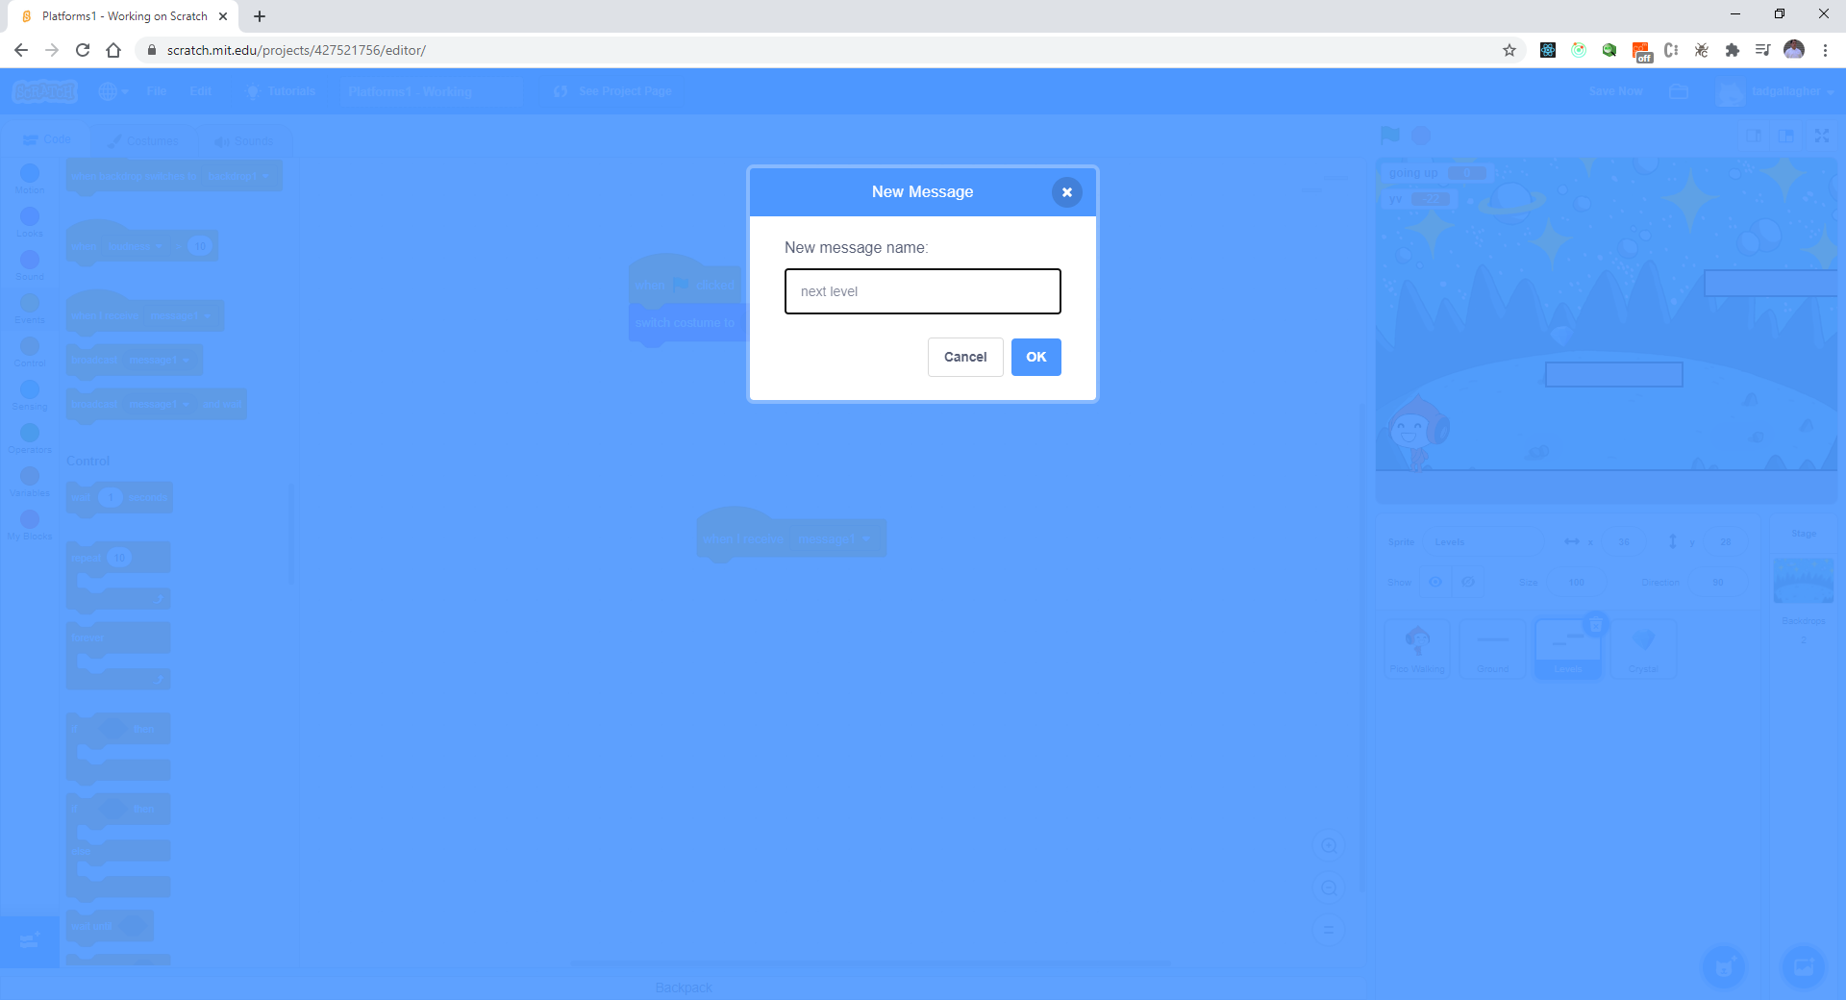
Enter message – next level

Slide 13
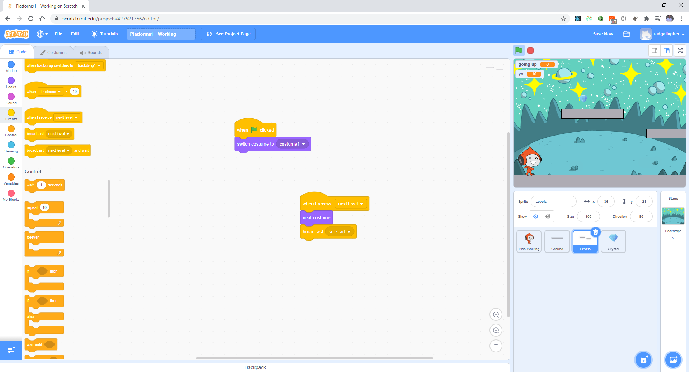

Slide 14

NOTE: Costumes are labeled as follows

Slide 15
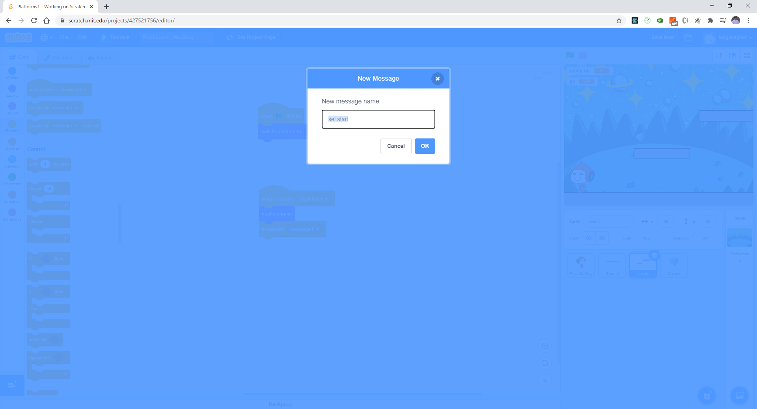
Add new message – “set start” to return Pico

Slide 16
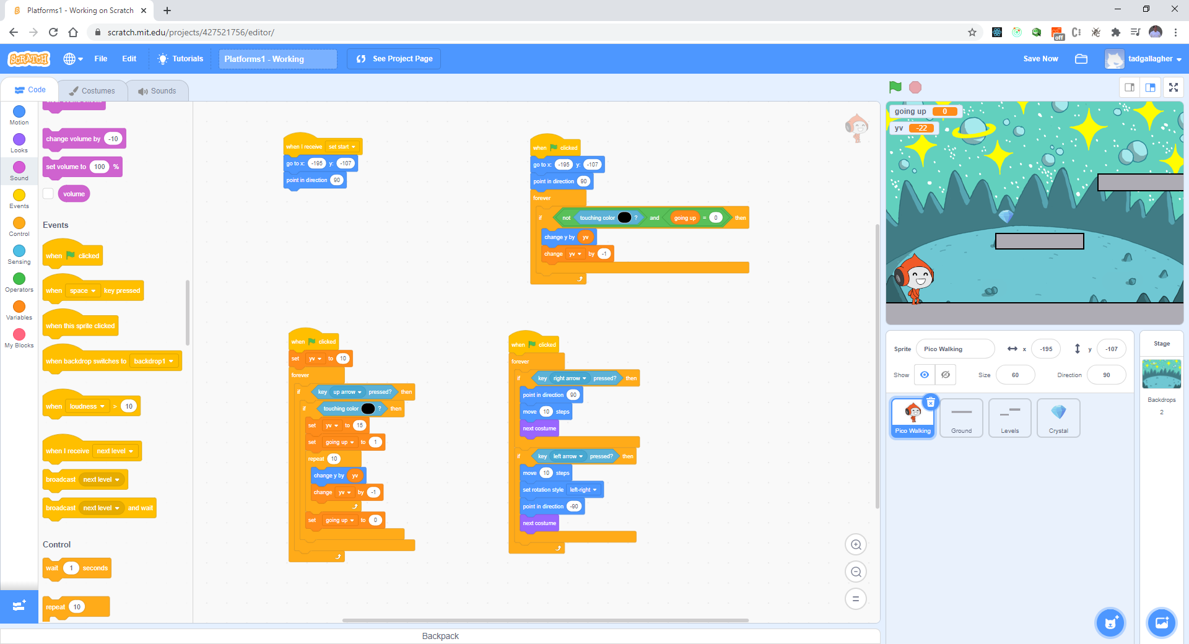
Add the following code for Pico

Slide 17
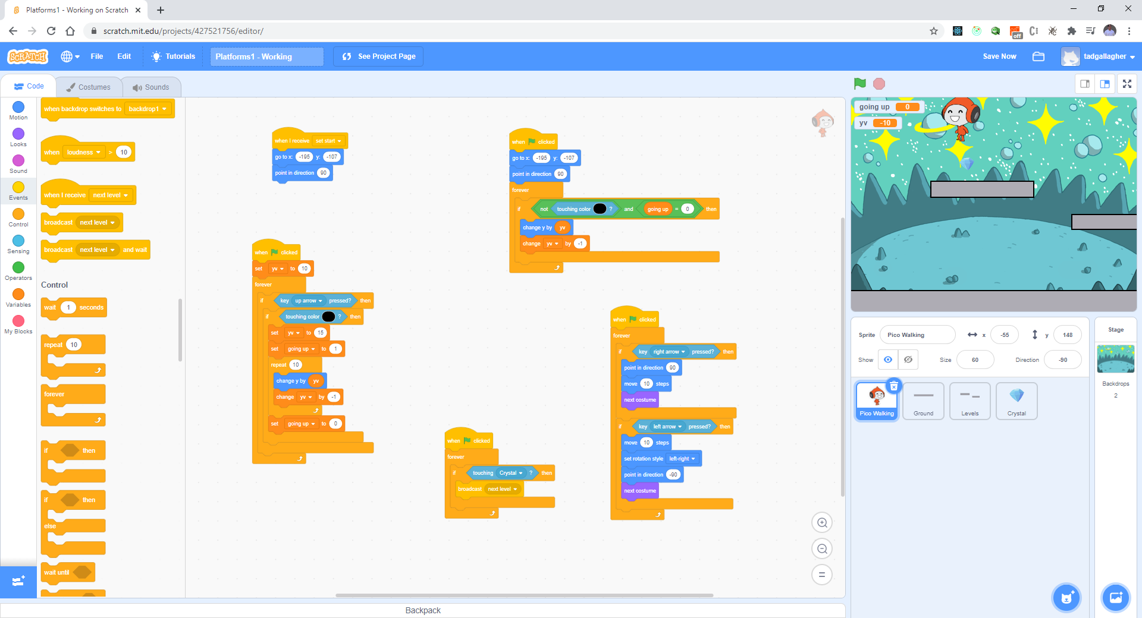
Add the rule for touching the diamond – make it disappear - add code

Slide 18
Test Code
Does the level change when you touch the diamond?
Any issues – let’s debug.

Slide 19
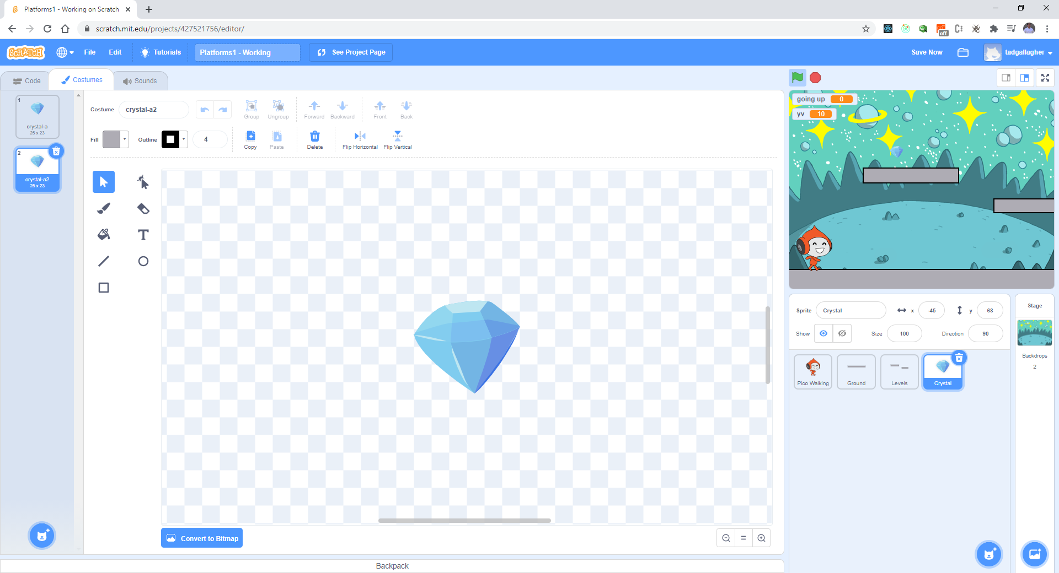
The diamond did not change it’s place to the new level – we need to fix this (duplicate)

Slide 20

Let’s move diamond (2) position as follows:

Slide 21
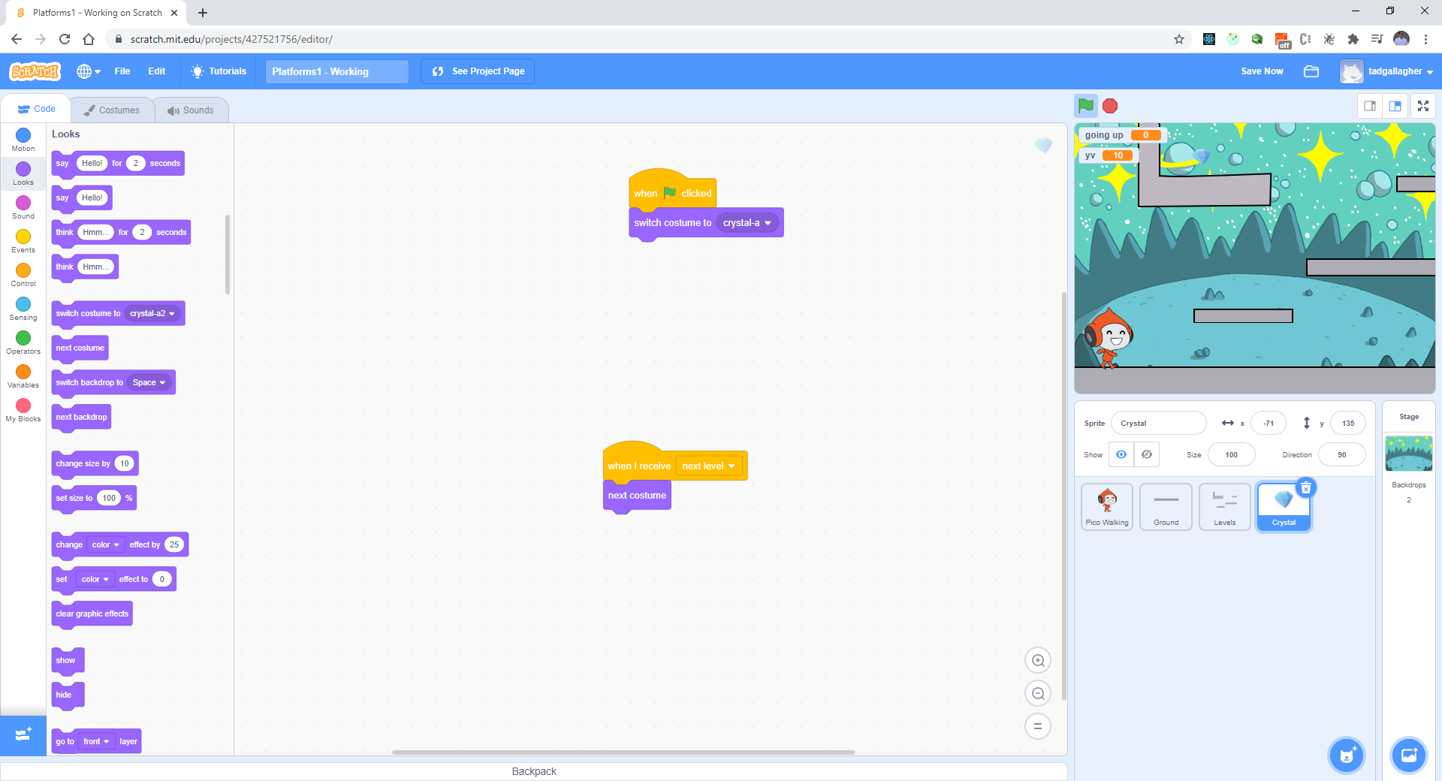
Add the following code for the diamond to position

Slide 22
Test your code
Are you able to switch levels?

